Slide 1
The AI Scientist -v2: Workshop-Level Automated Scientific Discovery via Agentic Tree Search
Yamada, Y., et al. (2025). The AI Scientist-v2: Workshop-Level Automated Scientific Discovery via Agentic Tree Search.
L215630 Abdul Hadi Durrani
L215620 Nawall Aamer
L216258 Soha Bilal
L215663 Abdullah Awan

Slide 2
Introduction
Automated Scientific Discovery:
Goal: AI systems that autonomously perform scientific research.
Challenges: Generating hypotheses, conducting experiments, and producing publishable results.
THE AI SCIENTIST-v1:
Generated a conference paper but relied on human templates and linear experimentation.
THE AI SCIENTIST-v2:
Offers greater autonomy and flexibility via agentic tree search and Vision-Language Model (VLM) integration.

Slide 3
Improvements Over THE AI SCIENTIST-v1
More General Idea Generation:
Open-ended, abstract ideas using literature review tools.
Removing Template Dependency:
Eliminates human-coded templates with experiment progress manager and tree search.
Dataset Loading via Hugging Face:
Easy access to diverse datasets.
Vision-Language Model Reviewer:
Refines figures and manuscripts for improved quality.

Slide 4
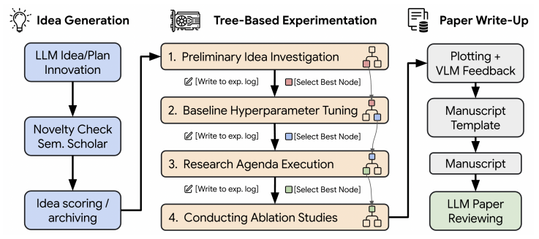
Methodology

Slide 5
Methodology Cont.
System Workflow:
Idea Generation: Proposes novel research directions.
Experiment Execution: Runs experiments autonomously.
Figure Visualization: Creates clear visual summaries.
Manuscript Writing: Drafts complete papers.
Reviewing: Refines content with VLM feedback.

Slide 6
Methodology Cont.
Agentic Tree Search:
Organizes experiments in a tree structure, where each node represents an experiment or code version.
Enables parallel execution of multiple experiment variants, speeding up exploration.
Iteratively refines experiments by selecting the best-performing nodes and debugging errors.

Slide 7
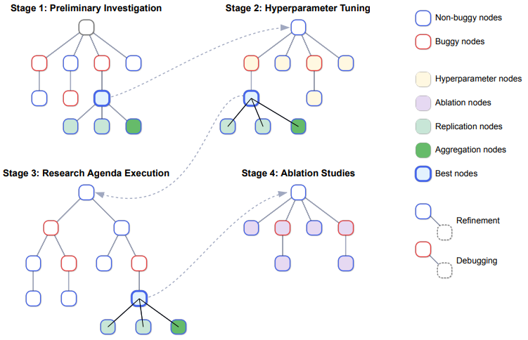
Tree-Based Experimentation

Slide 8
Tree-Based Experimentation Cont.
Agentic Tree Search Structure:
Root Node: Starts with initial experiment code generated from the research idea.
Child Nodes: Created for refinements (improving performance) or debugging (fixing errors).
Node Classification: Nodes are marked as buggy (errors detected) or non-buggy (successful execution).
Best Node Selection: An LLM evaluates nodes based on metrics like accuracy and visualization quality, selecting the best for the next stage.

Slide 9
Tree-Based Experimentation Cont.
Process Across Stages:
Parallel Execution: Multiple nodes are tested simultaneously to explore diverse hypotheses.
Iterative Refinement: Non-buggy nodes are refined for better results; buggy nodes are debugged using error logs.
Stage Transition: The best node from each stage seeds the next, ensuring continuous improvement.

Slide 10
Tree-Based Experimentation Cont.
Experiment Stages in Detail:
Preliminary Investigation: Builds and tests a minimal prototype to confirm the idea’s viability.
Hyperparameter Tuning: Adjusts parameters like learning rate or epochs to optimize the model’s performance.
Research Agenda Execution: Executes the main research plan, testing the hypothesis in depth.
Ablation Studies: Removes or modifies components to understand their impact, ensuring robust conclusions.

Slide 11
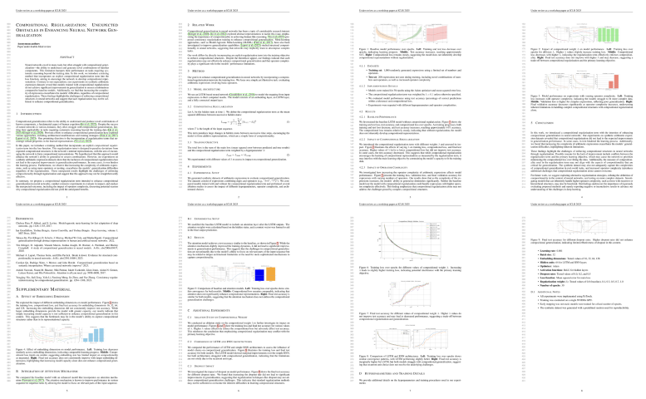
Evaluation

Slide 12
Evaluation Cont.
Submission to ICLR 2025 Workshop:
Three manuscripts submitted.
One accepted with scores: 6, 7, 6 (average 6.33).
Accepted Paper:
Title: Compositional Regularization: Unexpected Obstacles in Enhancing Neural Network Generalization
Focused on compositional regularization in neural networks.
First AI-generated peer-reviewed workshop paper.

Slide 13
Key Contributions
Development of THE AI SCIENTIST-v2:
Enhanced autonomy and exploration.
Novel use of agentic tree search and VLM feedback.
First AI-Generated Peer-Reviewed Paper:
Milestone in AI-driven scientific discovery.
Open-Sourcing:
Codebase and experiment data available for further research.

Slide 14
Ethical Considerations
Transparency:
Need to clearly label AI-generated research.
Community consensus required for integrating AI work into scientific records.
Practical Steps:
Withdrew accepted papers post-review to avoid premature inclusion.
Ensures ethical handling of AI-generated content.

Slide 15
Limitations and Future Work
Limitations:
May lack depth for conference-level standards.
Needs further methodological rigor.
Future Work:
Enhance AI’s ability for deeper, more complex research.
Explore applications in other scientific domains.

Slide 16
Conclusion
Achievements:
Demonstrated AI can autonomously produce peer-reviewed papers.
Highlighted AI’s potential in scientific discovery.
Implications:
Opens new avenues for AI-assisted research.
Raises ethical and practical questions for the scientific community.

Slide 17
Questions?

